Slide 1
Module-4
Loaders and Linkers

Slide 2
Syllabus
Introduction
Functions of loaders
Relocation & Linking concepts
Different Loading Schemes
Relocating Loader
Direct Linking Loader
Dynamic Linking & Loading

Slide 3
Loader
The loader is a program
which accepts the object program decks
prepares these programs for execution by the computer and
initiates the execution

Slide 4
Functions of a Loader
Allocation: Allocate space in memory for the programs

Slide 5
Functions of a Loader
Allocation: Allocate space in memory for the programs
Linking: Resolve symbolic references between object decks.

Slide 6
Functions of a Loader
Allocation: Allocate space in memory for the programs
Linking: Resolve symbolic references between object decks.
Relocation: Adjust all address dependent locations, such as address constants, to correspond to the allocated space.

Slide 7
Functions of a Loader
Allocation: Allocate space in memory for the programs
Linking: Resolve symbolic references between object decks.
Relocation: Adjust all address dependent locations, such as address constants, to correspond to the allocated space.
Loading: Physically place the machine instructions and data into memory.

Slide 8
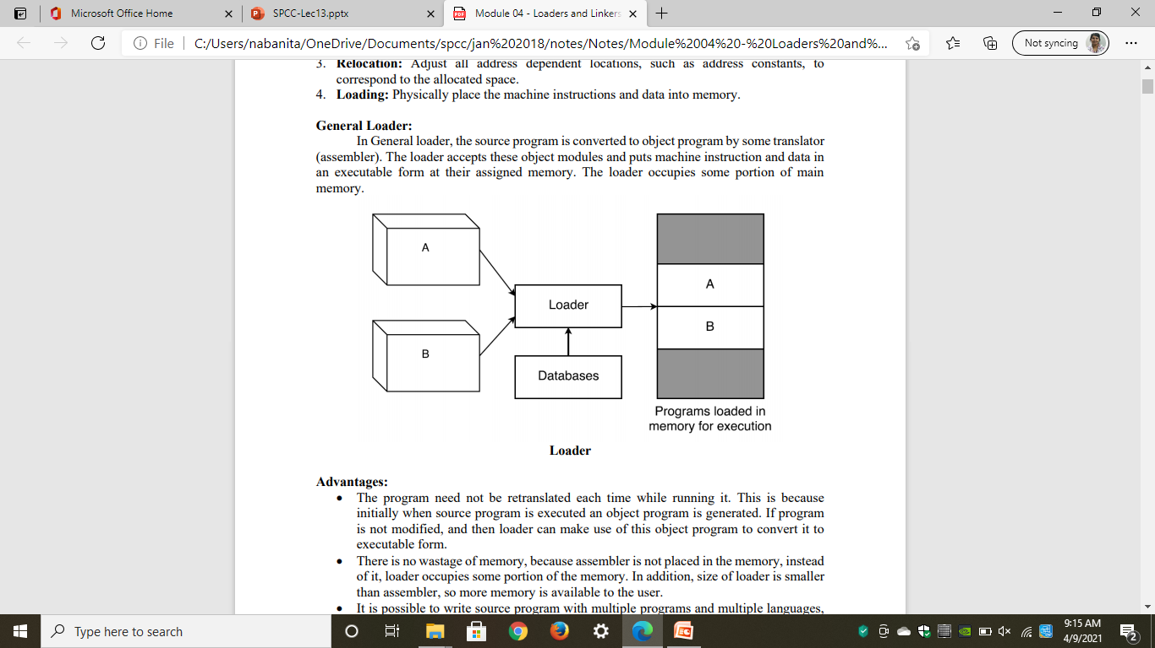
General Loading Scheme

Slide 9
General Loading Scheme
In General loader, the source program is converted to object program by some translator (assembler).

Slide 10
General Loading Scheme
In General loader, the source program is converted to object program by some translator (assembler).
The loader accepts these object modules and puts machine instruction and data in an executable form at their assigned memory.

Slide 11
General Loading Scheme
In General loader, the source program is converted to object program by some translator (assembler).
The loader accepts these object modules and puts machine instruction and data in an executable form at their assigned memory.
The loader occupies some portion of main memory

Slide 12
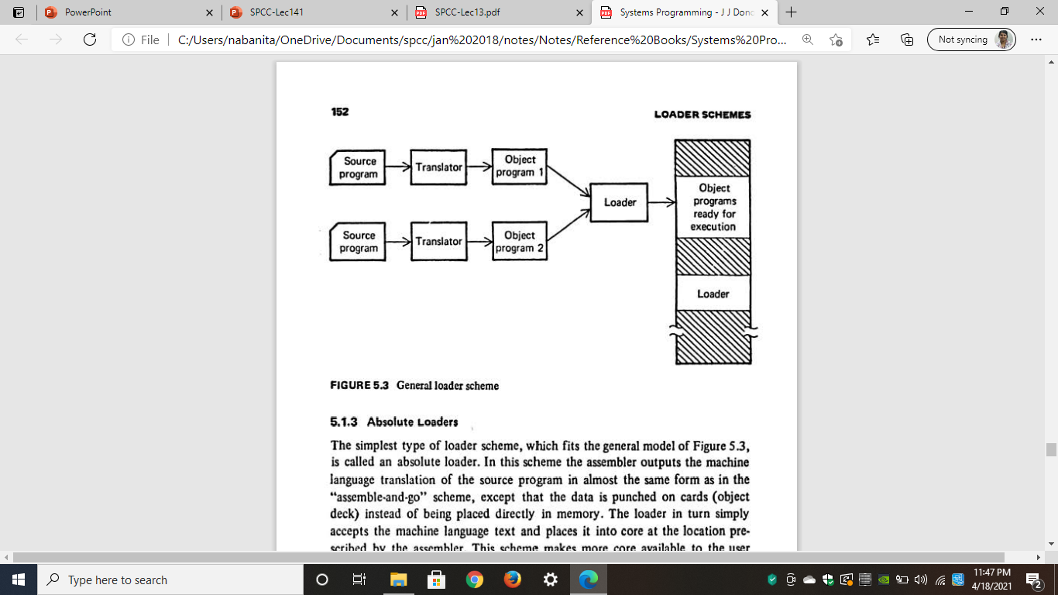
General Loading Scheme

Slide 13
Advantages:
No need of retranslation each time while running program

Slide 14
Advantages:
No need of retranslation each time while running program
No wastage of Memory
Loader occupies very less space in comparison with assembler

Slide 15
Advantages:
No need of retranslation each time while running program
No wastage of Memory
Loader occupies very less space in comparison with assembler
Possible to write source program with multiple programs and multiple languages

Slide 16
Linking
The execution of program can be done with the help of following steps:
1. Translation: Translation of the program (done by assembler or compiler)

Slide 17
Linking
The execution of program can be done with the help of following steps:
1. Translation: Translation of the program (done by assembler or compiler)
2. Linking: Linking of the program with all other programs, which are needed for execution. This also involves preparation of a program called load module.

Slide 18
Linking
The execution of program can be done with the help of following steps:
1. Translation: Translation of the program (done by assembler or compiler)
2. Linking: Linking of the program with all other programs, which are needed for execution. This also involves preparation of a program called load module.
3. Loading: Loading of the load module prepared by linker to some specified memory location.

Slide 19
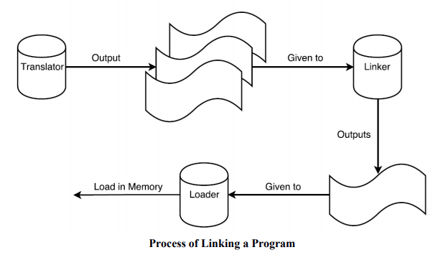
Process of Linking
The output of translator is a program called object module.

Slide 20
Process of Linking
The output of translator is a program called object module.
The linker processes these object modules, binds with necessary library routines and prepares a ready to execute program.

Slide 21
Process of Linking
The output of translator is a program called object module.
The linker processes these object modules, binds with necessary library routines and prepares a ready to execute program.
Such a program is called binary program.

Slide 22
Process of Linking
The output of translator is a program called object module.
The linker processes these object modules, binds with necessary library routines and prepares a ready to execute program.
Such a program is called binary program.
The "binary program also contains some necessary information about allocation and relocation.

Slide 23
Process of Linking
The output of translator is a program called object module.
The linker processes these object modules, binds with necessary library routines and prepares a ready to execute program.
Such a program is called binary program.
The "binary program also contains some necessary information about allocation and relocation.
The loader then loads this program into memory for execution purpose.

Slide 24
Tasks of a Linker
To prepare Single Load Module
Adjust all addresses & subroutine references with respect to the offset location
Concatenate all object modules
Adjust Operand Address References and External References with respect to offset location

Slide 25
Tasks of a Linker
To prepare Single Load Module
Adjust all addresses & subroutine references with respect to the offset location
Concatenate all object modules
Adjust Operand Address References and External References with respect to offset location
To prepare ready to execute module
Copy the binary machine instruction and constant data

